Slide 1


Slide 2


Phan Tuấn Kiệt 18600008
Trần Ngọc Như 18600198
La Thanh Tuấn 18600310

Slide 3



Slide 4


















World “Growth” Initiatives
Produktion
2030
Smart
Industry
Made
Difference
Industrial Internet Business Revolution
High Value
Manufacturing
Industry 4.0
Industry of the Future
Digital Manufacturing for SME
Manufacturing Renaissance
Innovation 25’ Program
Fabricacion
Avanzada
Produktionder Zukunft
Made In China 2025
Operational Programme
Fabbrica
Intelligente
Make in India
Precision
Manufacturing

Slide 5

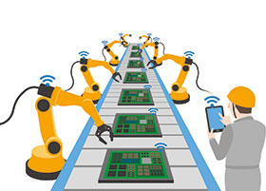


Industry 4.0
Stronger Customer Centricity
More Efficient Production Processes
Agility
Efficiency
INDUSTRY
4.0
Value Chain Transformation through Networked Processing & Objects
2019
Innovation
New Marketing & Business Models

Slide 6
Changying Precision Technology Company (Smart phone manufacturer)
 | Before | After
Number of employees | 650 | 60
Number of robots | 0 | 65
Defects (%) | 25% | Below 5% (80% reduction)
Production per person | 8000 | 21000 (more than 2.6 times)

Slide 7






Key components of current value chain
Tier N Suppliers
- Supply to tier 1
- Raw materials
- Located strategically to benefit from scale
Tier 1 Suppliers
- Manufacture and supply subsystems to OEMs
- Located closer for enabling JIT
Manufacturer
- High capex involved
- Covers a large geographical area
Channel Member
- Customer Facing
- Handles financing and insurance needs
- Some marketing efforts
Logistics
- Transport from OEM to the distributors/Dealer
After Sales Support
- Post Sale Customer Service
- On-Road Repair and Maintenance assistance
Source : engineersjournal.ie

Slide 8










Integrated reengineered value chain
Tier N Suppliers
Advanced Manufacturing Systems
Tier 1 Suppliers
- Fully integrated Supply Chain
- Perfect Coordination
Sensors
- Traceability
- Predictability
Manufacturer
3D Printing
- Scrap Elimination
- Customization
Alternate Resources
- Wind
- Solar
- Nuclear
Cloud Computing
- Big Data
- Cyber Security
Logistics
- Network Optimization
Robotics
- Autonomy
- Productivity
Channel
Member
After Sales Support

Slide 9



IoT will revolutionize the industry
Technology
Robotics – Replacing humans on assembly line
3D Printing – Manufacturing customized components
Big Data – Collecting performance parameters
Analytics – Understanding collected data
Process
Constant communication – Data exchange between components
Decentralized decision making – Routine decisions
Standardization – Ease of customization
Smart Transport System - Automated transportation of raw material / final products
People
Increased efficiency – Reduction in labor per unit
Skill Development – Up-skilling, Re-skilling, Continuous learning & Mindset change
Only to handle disruptions – Monitoring and corrective actions

Slide 10

1
2
Công nghiệp 4.0 là gì?
Sự phát triển
Khái quá về công ghiệp 4.0
Kỹ thuật – Vật lý – Sinh học
3
4
Lợi ích
Rủi ro và thách thức
Sản xuất và đời sống
Lao động và an toan thông tin

Slide 11
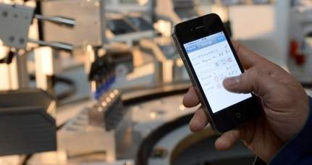
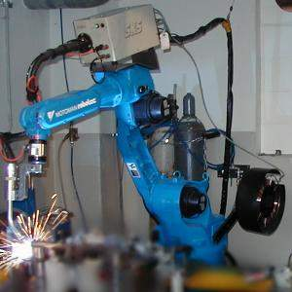
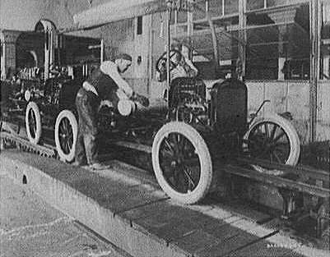
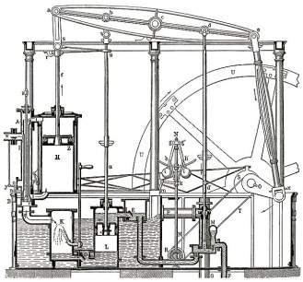
Industrial Evolution
4. Industrial revolution
Based on cyber-physical-
systems
3. Industrial revolution
Through the use of electronics
and IT further progression in
autonomous production
2. Industrial revolution
Introducing mass production
lines powered by electric
energy
Level of complexity
1. Industrial revolution
Introducing mechanical
production machines powered
by water and steam
Industry 1.0
Industry 2.0
Industry 3.0
Industry 4.0
End of the
18th century.
Beginning of the
20th century
Beginning of the
70th
Today
Source: DFKI/Bauer IAO

Slide 12
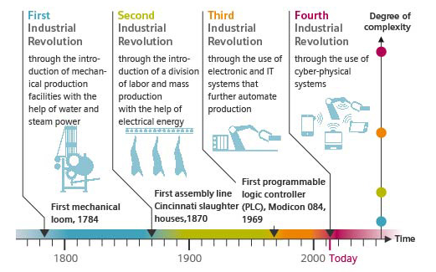
Industry 4.0: The Fourth Industrial Revolution
SOURCE: SIEMENS AG

Slide 13


Từ thế kỷ XVIII đến đầu thế kỷ XIX
Cuộc cách mạng công nghiệp 1.0
Sử dụng năng lượng nước và hơi nước để cơ giới hóa sản xuất.
1
2
Công nghiệp 4.0 là gì?
Sự phát triển
Khái quá về công ghiệp 4.0
Kỹ thuật – Vật lý – Sinh học
3
4
Lợi ích
Rủi ro và thach thức
Sản xuất và đời sống
Lao động và an toan thông tin

Slide 14
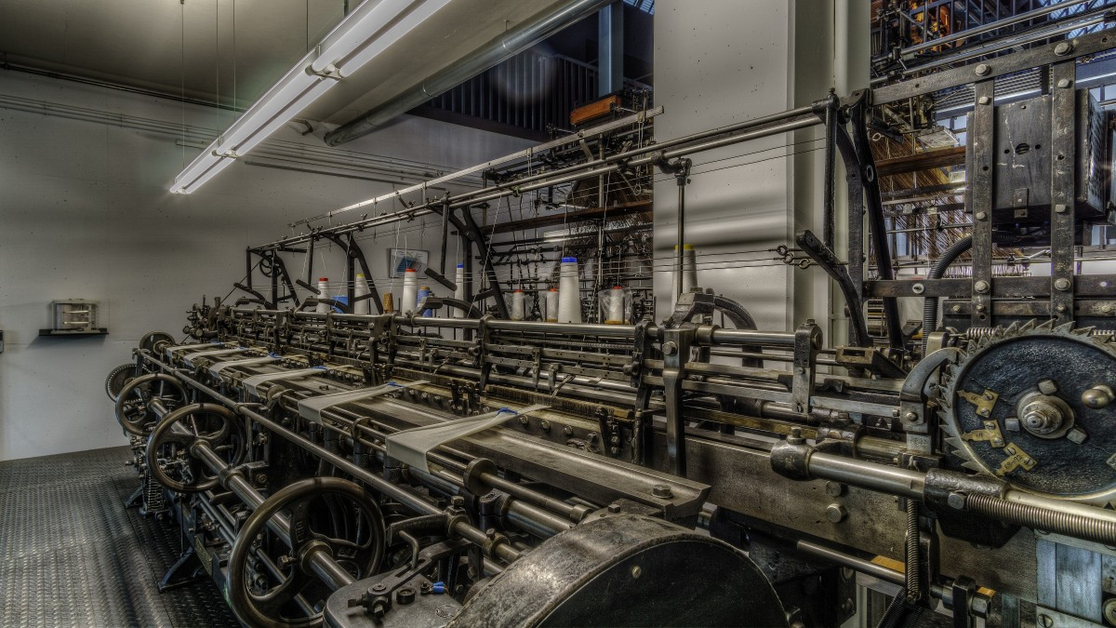
Nửa sau thế kỷ XIX đầu thế kỷ XX
Cuộc cách mạng công nghiệp 2.0
Nhờ ứng dụng điện năng để sản xuất hàng loạt.

Slide 15
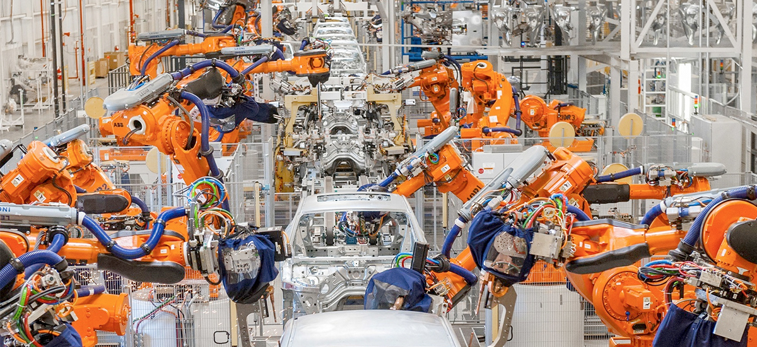
Cuối thế kỉ XX
Cuộc cách mạng công nghiệp 3.0
Sử dụng điện tử và công nghệ thông tin để tự động hóa sản xuất.

Slide 16
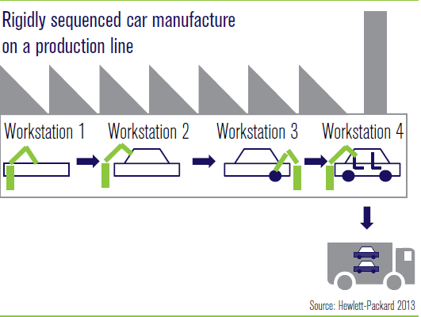
Today’s Factory

Slide 17
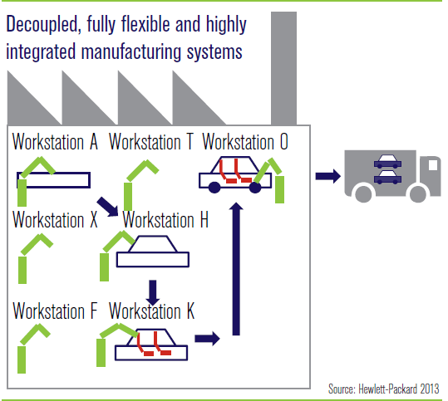
Tomorrow’s Factory

Slide 18


Là cuộc “Cách mạng số” chuyển hóa toàn bộ thế giới thực thành thế giới số.

Slide 19

Internet vạn vật (IoT)
Trí tuệ nhân tạo (AI)
Thực tế ảo (VR)
Tương tác thực tại ảo (AR)
Mạng xã hội, điện toán đám mây, di động, phân tích dữ liệu lớn (SMAC)…
Là chiến lược công nghệ cao, điện toán hóa ngành sản xuất mà không cần sự tham gia của con người.

Slide 20
Industry 4.0
SOURCE: CAPGEMINI

Slide 21
Industry 4.0 Smart Factory
CPPS = CYBER-PHYSICAL PRODUCTION SYSTEM
M2M = MACHINE-TO-MACHINE
SOURCE: CAPGEMINI

Slide 22
Industry 4.0 Smart Factory
SOURCE: ROLAND BERGER STRATEGY CONSULTANTS

Slide 23
Industry 4.0 Supply Chain
RAW MATERIAL
SUPPLIER
MANUFACTURER
CUSTOMER
END USER
LOGISTICS
LOGISTICS
LOGISTICS
SUPPLY CHAIN:
SOURCE: CAPGEMINI

Slide 24










Some Industry 4.0 Technologies
End-to-end (E2E) process management
Smart, autonomous assets
3D printing & virtualization
New digital business models
Digital workflows and platforms
Human interaction
Big data
Logistics systems across the networked industry
SOURCE: PROF. DR. ANDRÉ LUDWIG

Slide 25
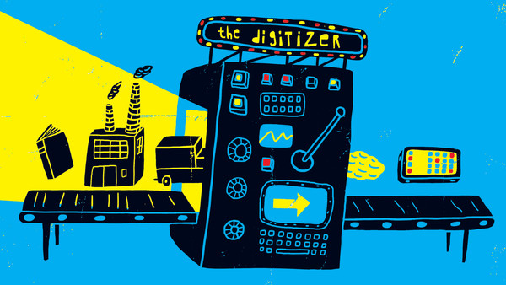
Soon Everything Will Be Smart
SOURCE: PROF. DR. ANDRÉ LUDWIG

Slide 26
Connected Devices Projection
(Conservative)
World Population
6.3 Billion
6.8 Billion
7.2 Billion
7.6 Billion
Connected Devices
500 Million
12.5 Billion
25 Billion
50 Billion
Connected Devices Per Person
0.08
More connected devices than people
1.84
3.47
6.58
2003
2008
2010
2015
2020
SOURCE: CISCO
Notes:
In 2003, there were approximately 6.3 billion people living on the planet and 500 million devices connected to the Internet. (Sources: U.S. Census Bureau, 2010; Forrester Research, 2003). By dividing the number of connected devices by the world population, we find that there was less than one (0.08) devices for every person.
At this time, the Internet of Things (the point when more things are connected to the Internet than people) didn’t yet exist because the number of connected “things” was relatively small given that ubiquitous devices such as smartphones including the Apple iPhone were just being introduced. Steve Jobs, Apple’s CEO, in fact, unveiled the iPhone to the public on January 9, 2007 at Macworld 2007. (Source: Wikipedia, 2010).
Between 2007 and today, the number of connected devices ballooned due to advances in smartphones, tablet PCs, and so on.
This explosive growth brought the number of devices connected to the Internet to 12.5 billion in 2010, while the number of people living on earth increased to 6.8 billion. (Sources: Cisco IBSG, 2010; U.S. Census Bureau, 2010).
Cisco IBSG believes the Internet of Things was born between 2008 and 2009.
Today, the Internet of Things is well underway, as initiatives such as planetary skin, the smart grid, tablet PCs, and intelligent vehicles take hold and flourish.
Looking to the future, Cisco IBSG predicts there will be 25 billion devices connected to the Internet by 2015 and 50 billion by 2020. This growth will come largely from future initiatives such as sensor networks and connected buildings.
It is important to understand that Cisco IBSG’s estimates for connected devices do not take into account any unforeseen advances or innovations in Internet or device technology. The numbers presented here are based solely on applying what we know to be true today.
In addition, the number of connected devices per person may seem low. This is because we are basing our calculation on the entire world population, many of whom are not connected to the Internet yet. By reducing the population sample to the number of people actually connected to the Internet, the number of connected devices per person goes up dramatically. For example, we know that approximately 2 billion people use the Internet today. (Source: World Internet Stats, June 30, 2010). Using this figure, the number of connected devices per person is 6.25 in 2010 instead of 1.84.
Note
Calculations are based on number of connected IP devices.
Source Detail
Forrester Research
(From Inforworld story dated March 10, 2003, titled, “Forrester CEO: Web services next IT storm”)
http://www.infoworld.com/t/platforms/forrester-ceo-web-services-next-it-storm-873
Today about 500 million devices are connected, by the end of the decade there will be billions of connected devices, including cars, phones and many other electronic devices. –George Colony, Forrester Research founder and chief executive officer
Internet World Stats
Internet Usage Statistics, The Internet Big Picture, World Internet Users and Population Stats, June 30, 2010
http://www.internetworldstats.com/stats.htm
U.S. Census Bureau
U.S. Census Bureau, 2010, “Total Midyear Population for the World: 1950-2050,”
(Data updated 6-28-2010)
http://www.census.gov/ipc/www/idb/worldpop.php
Wikipedia
http://en.wikipedia.org/wiki/IPhone
Jobs unveiled the iPhone to the public on January 9, 2007 at Macworld 2007. Apple was required to file for operating permits with the FCC, but since such filings are made available to the public, the announcement came months before the iPhone had received approval. The iPhone went on sale in the United States on June 29, 2007, at 6:00 pm local time, while hundreds of customers lined up outside the stores nationwide. The original iPhone was made available in the UK, France, and Germany in November 2007, and Ireland and Austria in the spring of 2008.
Methodology
Cisco IBSG determined the number of connected devices per year by applying the theory of Moore’s Law (or the doubling of processing power every 5.32 years) to the estimated number of connected devices in 2003 according to Forrester Research. The number of connected devices was then divided by the world population as determined by the U.S. Census Bureau to come up with the number of connected devices per person.
###

Slide 27
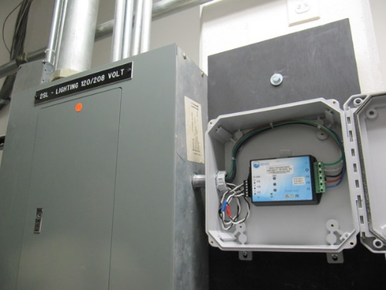

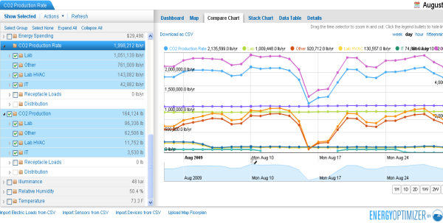








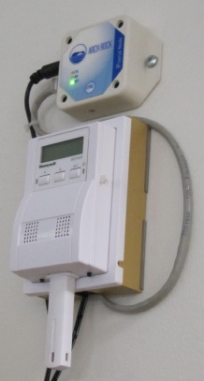

Smart Buildings
Dashboards
Internet
AC power sub-meters
Gas/Water sub-meters
Temp, Hum., Light, CO₂ sensors
Outdoor temperature
Relay nodes
Routers
SOURCE: CISCO

Slide 28
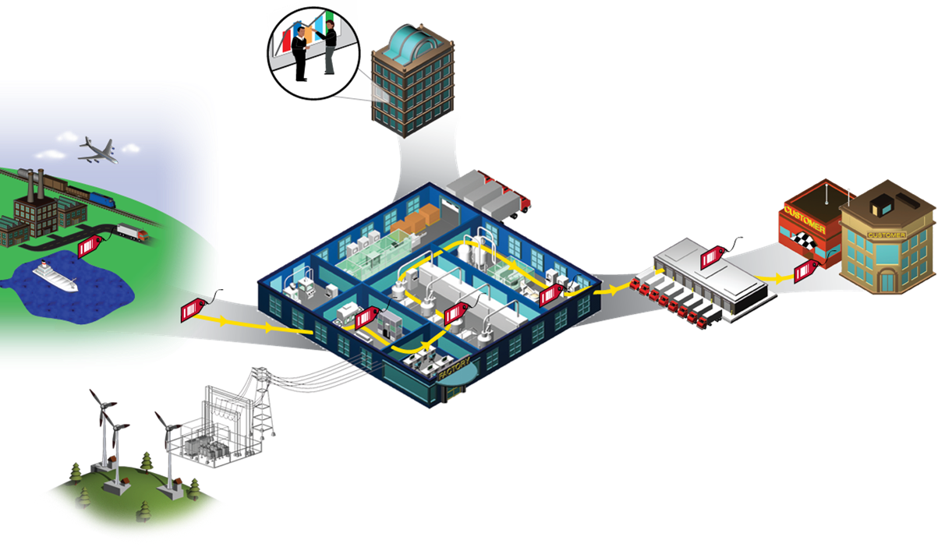
Smart Manufacturing
Business Systems, ERP
Customer
Supply Chain
Distribution Center
Smart Factory
Dynamic plant configuration, readiness
Dynamic product configuration
Dynamic inventory minimization
Smart Grid
SOURCE: ROBERT GRAYBILL

Slide 29
Building blocks of Industry 4.0
Industry 4.0
Autonomous Robots
Simulation
Horizontal and vertical system integration
Additive Mfg
Industrial Internet of Things
Augmented reality
Big data analytics
Cyber Security

Slide 30
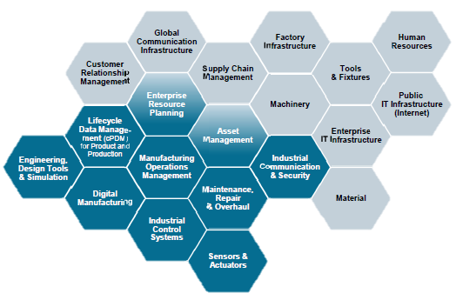
Impacting all aspect of value chain

Slide 31
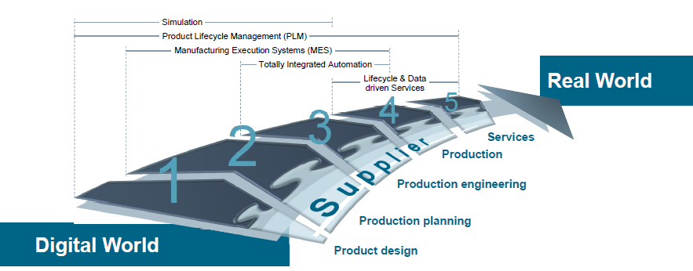
Digital Enterprise Entire value chain is digitized and integrated

Slide 32
Potential Implications
Robot Assisted production
Additive manufacturing of complex parts
Machines as a service
Big data drive quality control
Production line simulation
Predictive Maintenance
Smart supply network

Slide 33
Robots working in Amazon WH

Slide 34


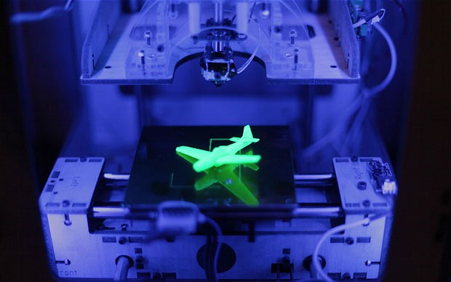

SỰ PHÁT TRIỂN
Yếu tố kỹ thuật
Công nghệ sinh học
Vật lý

Slide 35




SỰ PHÁT TRIỂN
Yếu tố kỹ thuật
Công nghệ sinh học
Vật lý

Slide 36
SỰ PHÁT TRIỂN
Yếu tố kỹ thuật
Công nghệ sinh học
Vật lý

Slide 37
SỰ PHÁT TRIỂN
Công nghệ sinh học
Công nghệ chỉnh sửa gen
01
Chỉnh sửa
Tái cấu trúc
Xóa bỏ ADN
Liệu pháp gen
02
Điều trị bệnh bằng cách chèn gen vào tế bào thay vì dùng thuốc
Công nghệ Nano
03
Sử dụng các thiệt bị có kích thước và vật liệu trên quy mô từ 1 – 100 nm
Yếu tố kỹ thuật
Vật lý

Slide 38
SỰ PHÁT TRIỂN
Yếu tố kỹ thuật
Công nghệ sinh học
Vật lý

Slide 39
SỰ PHÁT TRIỂN
Vật lý
Công nghệ in 3D: tạo ra các vật bằng việc in các lớp từ bản vẽ 3D.
Vật liệu mới: mang những thuốc tính từng bị coi là viễn tưởng như nhẹ hơn, bền hơn, có khả năng tái chế và dễ thích ứng.
Yếu tố kỹ thuật
Công nghệ sinh học

Slide 40

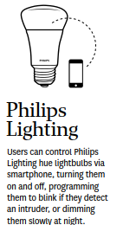
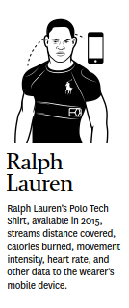
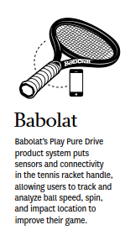
Examples of Product evolution: Connected and smart products

Slide 41

Lợi ích

Slide 42

Impact Economy
Growth
Ageing
Productivity
Employment
Labour subsititution
The nature of Work
Notes:
It is possible to apply this template to exiting presentations.
Have the latest presentation template open
Click on the View tab and select Normal
Delete all unwanted slides
Click on the Insert tab from the menu bar and select Slides from Files
Click on Browse. Navigate to the presentation you wish to update with the new template. Highlight the presentation and click Open
Wait for the slides from the presentation to load and click on Insert All. Then click Close
Check the inserted slides to ensure that the most appropriate master slide has been used on each slide
To change the master applied to a slide select the slide you wish to apply a different master to then click on the Format tab from the menu bar and select Slide Design
From the Used in This Presentation section choose the master you wish to apply to the slide and hover over it to reveal a drop-down arrow. Click on the arrow and select Apply to Selected Slides
It is important to thoroughly check the presentation to ensure that no further formatting is needed.

Slide 43
Impact Business
Customer expectations
Data enhanced products
Collaborative innovation
New operating models
Combining digital, physical and biological worlds
Notes:
It is possible to apply this template to exiting presentations.
Have the latest presentation template open
Click on the View tab and select Normal
Delete all unwanted slides
Click on the Insert tab from the menu bar and select Slides from Files
Click on Browse. Navigate to the presentation you wish to update with the new template. Highlight the presentation and click Open
Wait for the slides from the presentation to load and click on Insert All. Then click Close
Check the inserted slides to ensure that the most appropriate master slide has been used on each slide
To change the master applied to a slide select the slide you wish to apply a different master to then click on the Format tab from the menu bar and select Slide Design
From the Used in This Presentation section choose the master you wish to apply to the slide and hover over it to reveal a drop-down arrow. Click on the arrow and select Apply to Selected Slides
It is important to thoroughly check the presentation to ensure that no further formatting is needed.

Slide 44
Impact
National & Global
Governments
Countries, regions & cities
International security
Society
Inequality
Community
The Individual
Identity, morality & ethics
Human connection
Notes:
It is possible to apply this template to exiting presentations.
Have the latest presentation template open
Click on the View tab and select Normal
Delete all unwanted slides
Click on the Insert tab from the menu bar and select Slides from Files
Click on Browse. Navigate to the presentation you wish to update with the new template. Highlight the presentation and click Open
Wait for the slides from the presentation to load and click on Insert All. Then click Close
Check the inserted slides to ensure that the most appropriate master slide has been used on each slide
To change the master applied to a slide select the slide you wish to apply a different master to then click on the Format tab from the menu bar and select Slide Design
From the Used in This Presentation section choose the master you wish to apply to the slide and hover over it to reveal a drop-down arrow. Click on the arrow and select Apply to Selected Slides
It is important to thoroughly check the presentation to ensure that no further formatting is needed.

Slide 45
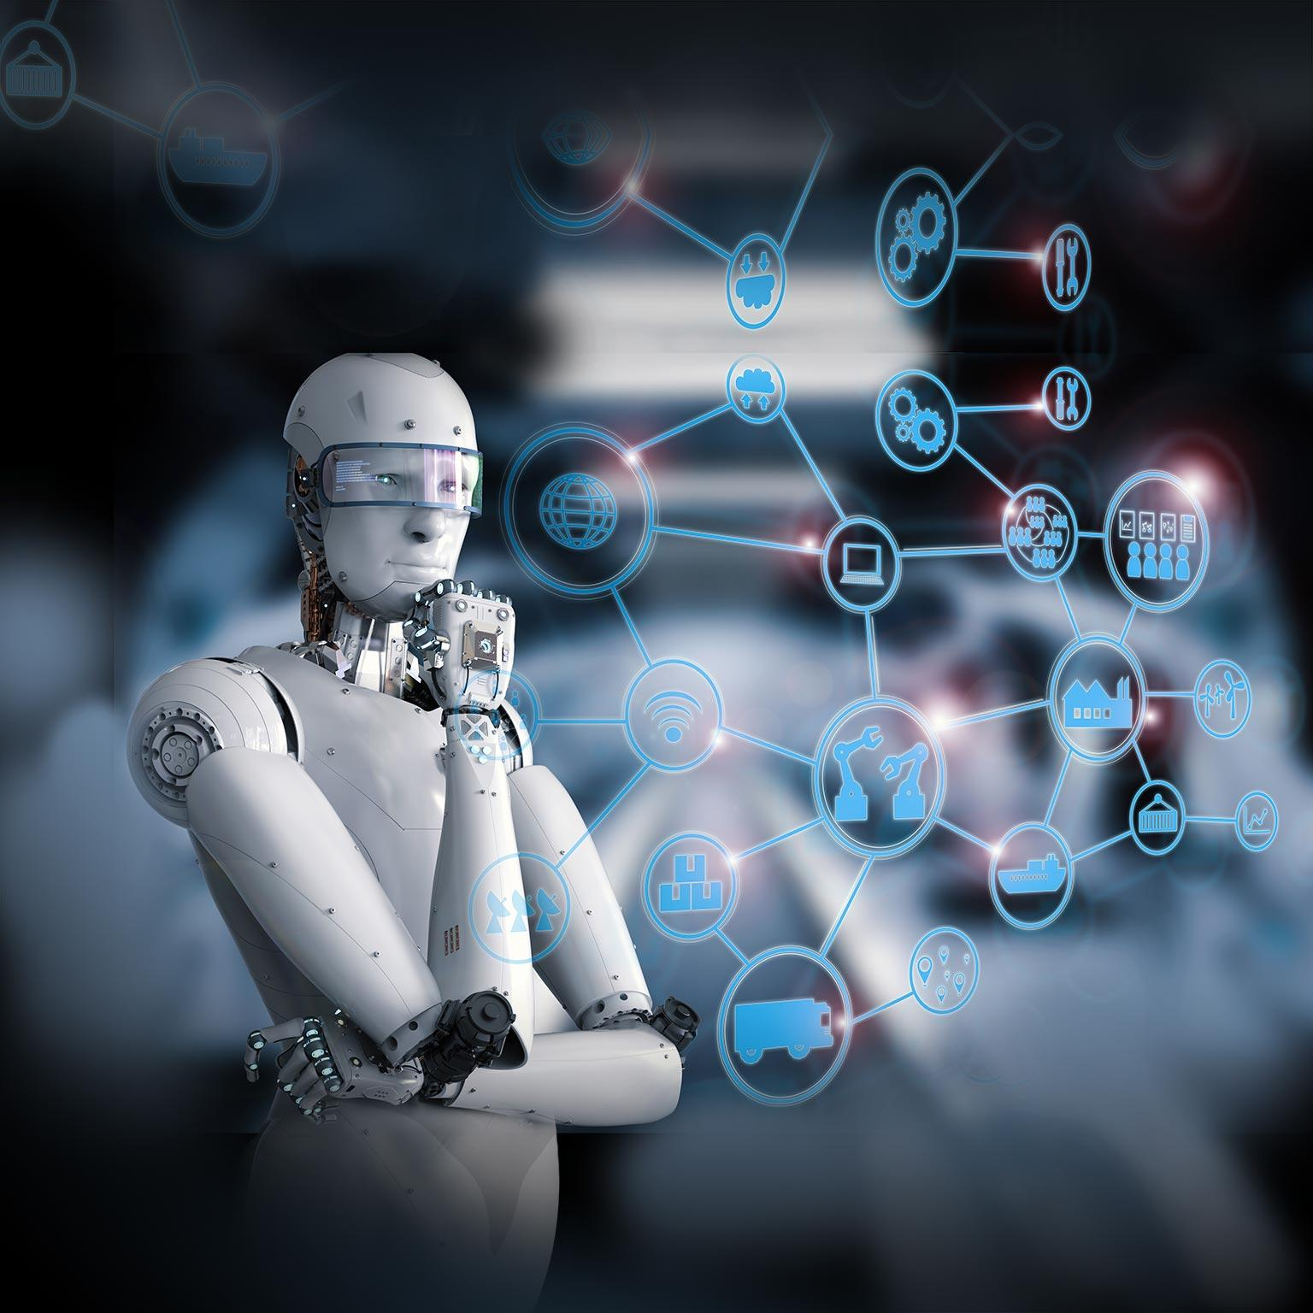
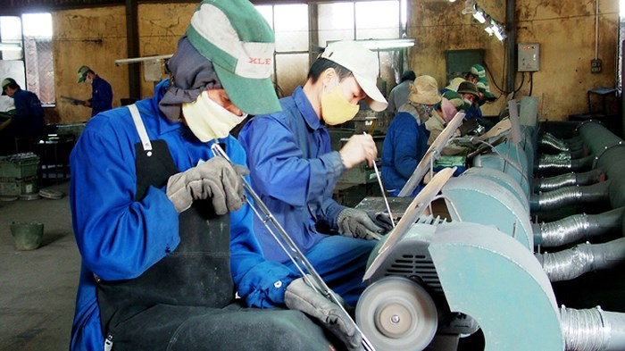
Thách thức
Rủi ro
Vs

Slide 46

Thách thức
Vs
Rủi ro

Slide 47
Vs

Slide 48


Bảo mật thông tin

Slide 49

Tự tìm tòi
học hỏi
trau dồi kỹ năng

Slide 50

Cám ơn mọi người đã lắng nghe

Slide 51
Cám ơn mọi người đã lắng nghe
Những công việc các thành viên đảm nhận
Tổng hợp nội dung:
La Thanh Tuấn
Thực hiện nội dung:
Trần Ngọc Như
Thực hiện Slide thuyết trình:
Phan Tuấn Kiệt

Slide 52

?
?
?
?
?
?
?
?

